Slide 1

Your Lifestyle Guide to the Adirondacks

Slide 2
Why Advertise On Adirondack.net?
3.26+
million
Page Views Each Year
255,000+
Social Media Followers
11,000+
Newsletter
Subscribers
A leading resource on all things Adirondacks for more than a decade
An engaged and growing social media audience
Top placements in Google for targeted keywords and phrases related to the Adirondacks
Content that users need: events, things to do, business reviews, & information

Slide 3






The Adirondack.net Audience
52% female
56% ages 25-54
50% have children
57% $50,000+ annual income
64% College or higher education
Top 3 Metros: Albany-Schenectady-Troy, New York City, Syracuse

Slide 4
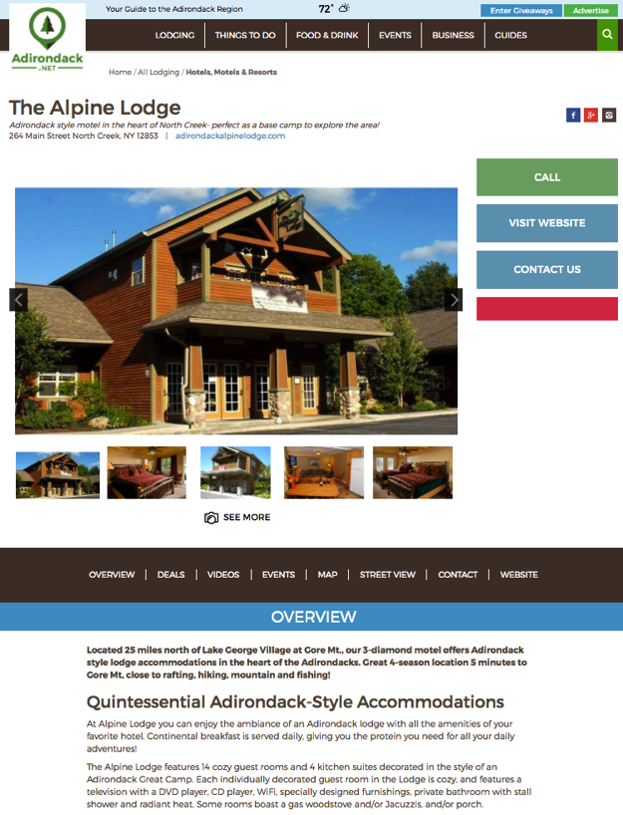
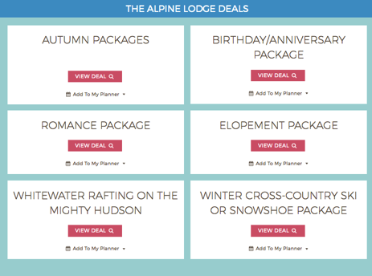
Custom Micro-Sites
Listed on relevant category directory pages
Includes personalized business description, photo gallery, website & social media links & more
Allows event uploads that feed into our events calendar
Multiple Calls-to-Action for Lead Generation

Slide 5
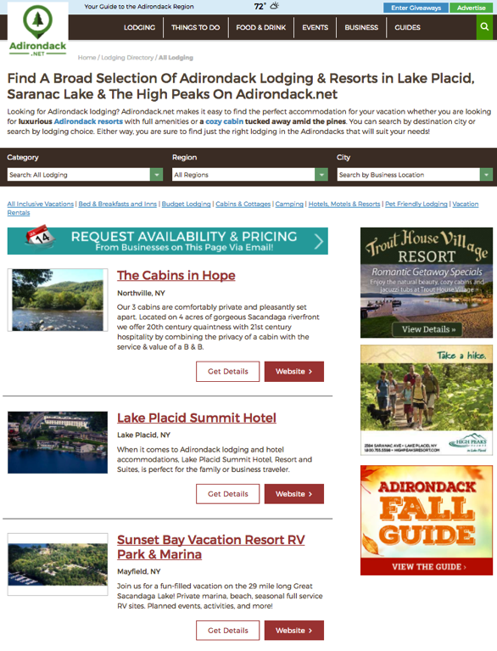
Display Advertising
Promote your brand, your offer, or your event throughout the Adirondacks
Create top of mind awareness with a visually appealing ad and strong call to action
Maximize your impact by targeting your ad to relevant sections of the site
Get measurable results for optimal ROI
Display Ads

Slide 6
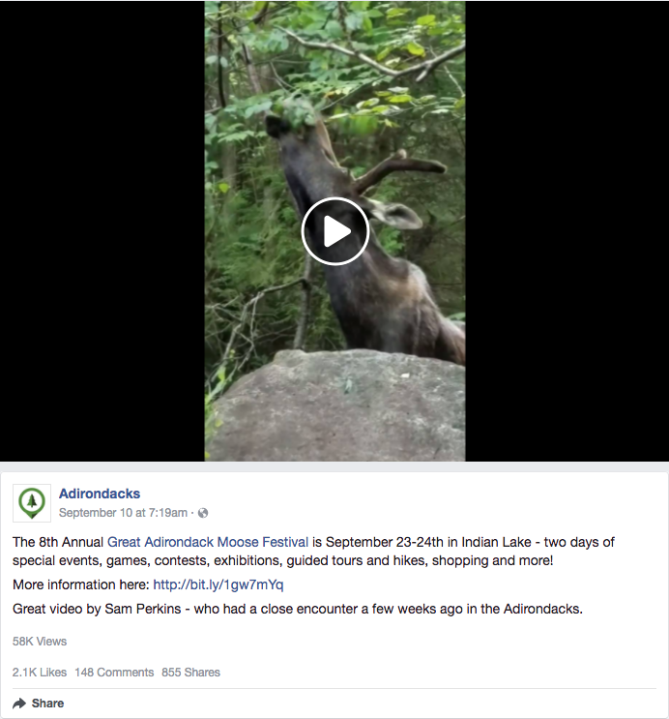
Social Media Marketing
Reach people who love the Adirondacks on the platform they use most
Over 255,000 fans across multiple channels including Facebook & Twitter
Great for promoting your newest products, specials, events and more
Boost your posts and reach a larger audience or target a specific demographic

Slide 7
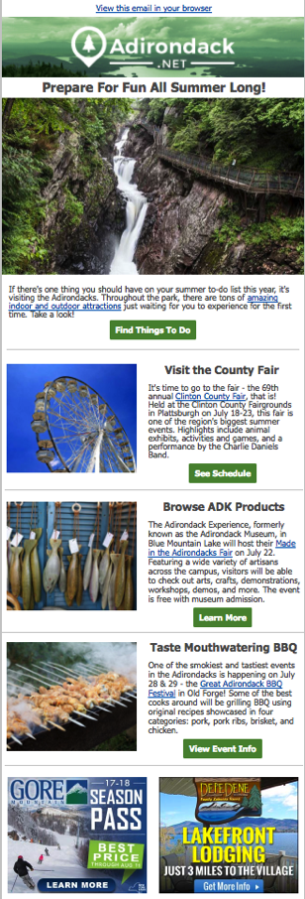
E-Mail Newsletters
Advertise directly where your consumers are everyday – their inbox! It's millennials preferred format for receiving promotional content.
Promote upcoming events, things to do, travel packages, dining, specials and more to an active and engaged audience.

Slide 8

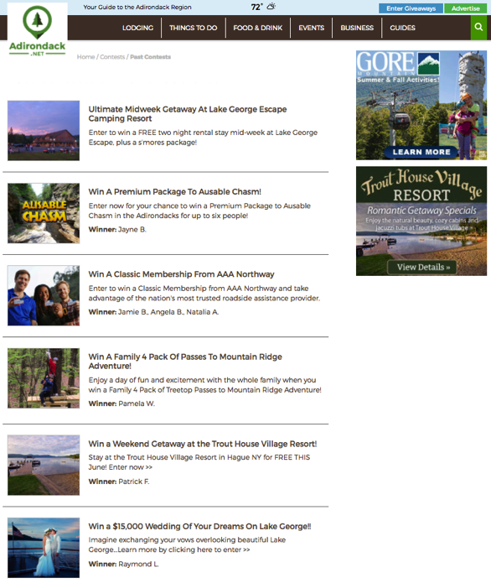
Giveaways
This popular section of Adirondack.net is promoted on our homepage, newsletters, and social media channels
Increase Brand Recognition
Build lead generation for future e-mail marketing with opted-in subscribers*
Gain social media followers with a targeted giveaway section that encourages “likes”
*Optional with some programs

Slide 9
Want to reach a highly engaged audience looking for places to go and things to do?
Contact us about a custom marketing solution for your business.
Call or E-mail
Rick Marchant
Internet Marketing Specialist - Albany.com
Email: Rick@Albany.com
Mobile: (518) 932-8277
Office: (518) 743-9424 x228
Fax: (518) 743-0337

