Slide 1
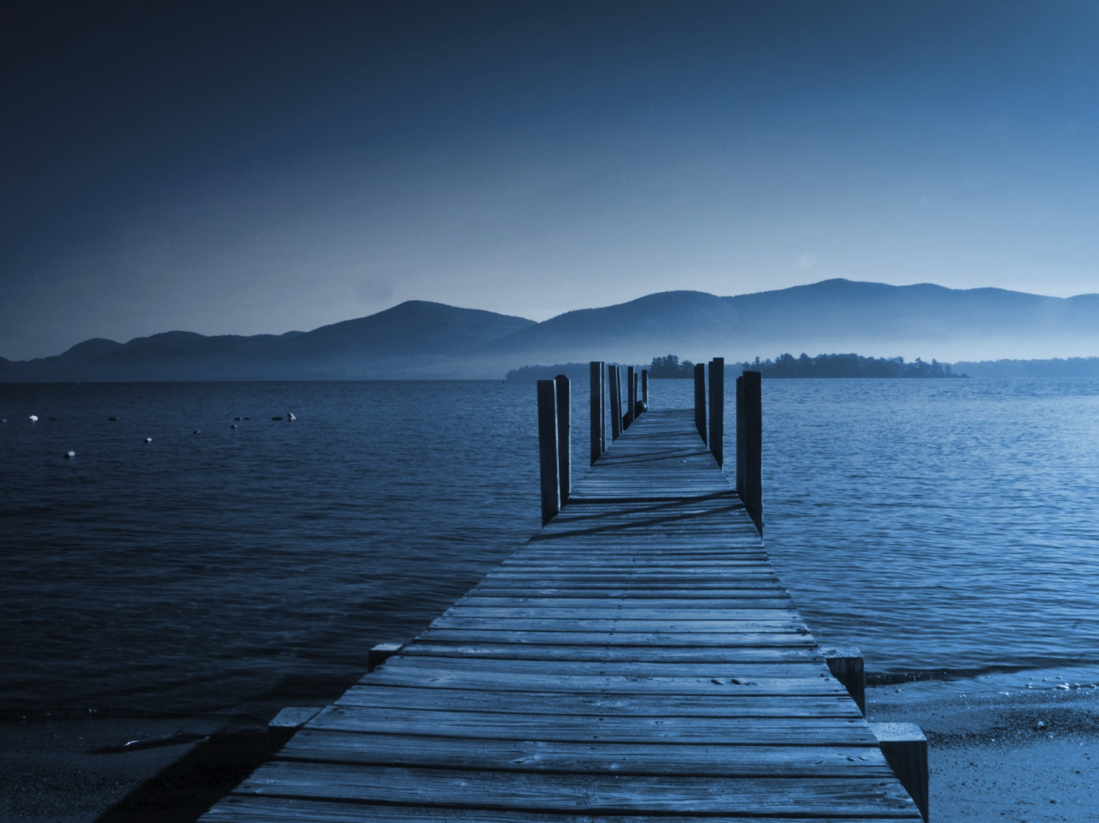
Your Lifestyle Guide to Lake George

Slide 2
Why Advertise On LakeGeorge.com?
8.06+
million
Page Views Each Year
Nearly
200,000
Social Media Followers
29,700+
Newsletter
Subscribers
A leading resource on all things Lake George for more than a decade
An engaged and growing social media audience
Top placements in Google for targeted keywords and phrases related to Lake George
Content that users need: events, things to do, business reviews, & information

Slide 3






The LakeGeorge.com Audience
60% female
65% ages 25-54
56% have children
62% $50,000+ annual income
60% College or higher education
Top 3 Metros: New York City, Albany-Schenectady-Troy, Boston MA-Manchester NH

Slide 4
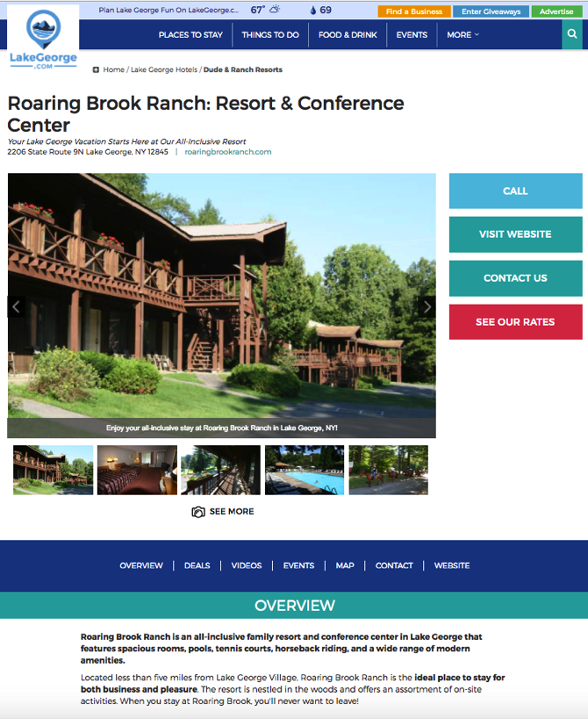
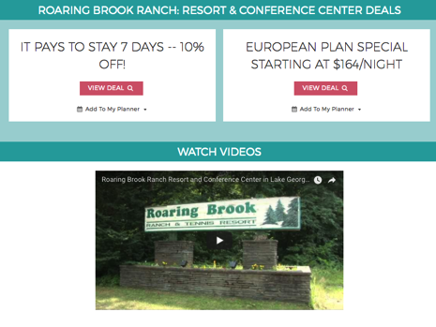
Custom Micro-Sites
Listed on relevant category directory pages
Includes personalized business description, photo gallery, website & social media links & more
Allows event uploads that feed into our events calendar
Multiple Calls-to-Action for Lead Generation

Slide 5
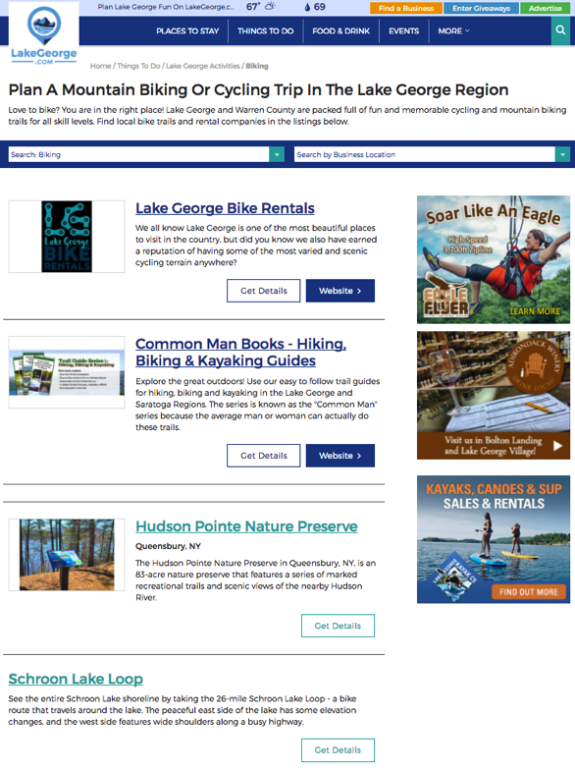
Display Advertising
Promote your brand, your offer, or your event throughout the Lake George Area
Create top of mind awareness with a visually appealing ad and strong call to action
Maximize your impact by targeting your ad to relevant sections of the site
Get measurable results for optimal ROI
Display Ads

Slide 6
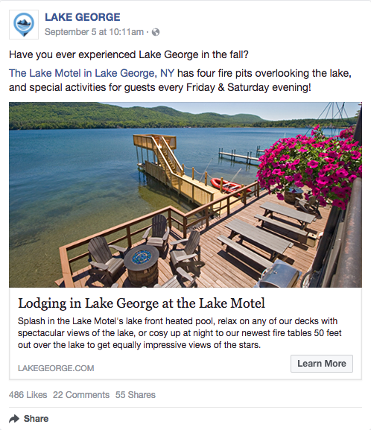
Social Media Marketing
Reach people who love Lake George on the platform they use most
Nearly 200,000 fans across multiple channels including Facebook & Twitter
Great for promoting your newest products, specials, events and more
Boost your posts and reach a larger audience or target a specific demographic

Slide 7
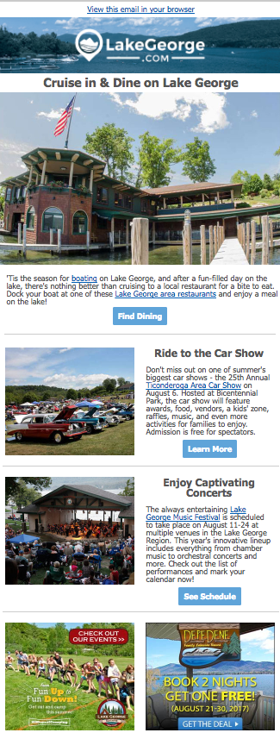
E-Mail Newsletters
Advertise directly where your consumers are everyday – their inbox! It's millennials preferred format for receiving promotional content.
Promote upcoming events, things to do, travel packages, dining, specials and more to an active and engaged audience.

Slide 8

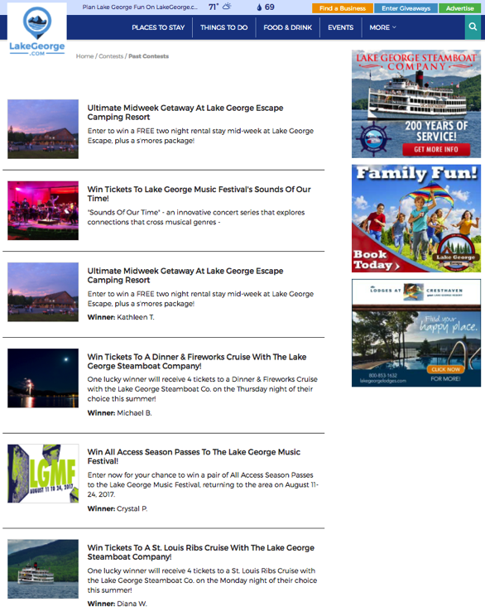
Giveaways
This popular section of LakeGeorge.com is promoted on our homepage, newsletters, and social media channels
Increase Brand Recognition
Build lead generation for future e-mail marketing with opted-in subscribers*
Gain social media followers with a targeted giveaway section that encourages “likes”
*Optional with some programs

Slide 9
Want to reach a highly engaged audience looking for places to go and things to do?
Contact us about a custom marketing solution for your business.
Call or E-mail
Rick Marchant
Internet Marketing Specialist - Albany.com
Email: Rick@Albany.com
Mobile: (518) 932-8277
Office: (518) 743-9424 x228
Fax: (518) 743-0337

